Slide 1
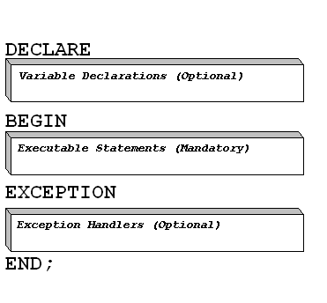
PL/SQL Block

Slide 2
Q. Write a PL/SQL block which will accept a value from the user and it will insert the factorial result into a table called result.
SQL> create table result(factorial number(10));
Table created.
SQL> declare
2 factorial number(10):=1;
3 i number(3):=1;
4 n number(3);
5 begin
6 n:=&n;
7 while i<=n
8 loop
9 factorial:=factoril*i;
10 i:=i+1;
11 end loop;
12 insert into result values(factorial);
13 end;
14 /

Slide 3
Enter value for n: 5
old 6: n:=&n;
new 6: n:=5;
PL/SQL procedure successfully completed.
SQL> select * from result;
FACTORIAL
----------
120

Slide 4
Q. Write a PL/SQL procedure which will calculate whether a number is odd or even.
SQL> create or replace procedure abcde(num in number)
2 is
3 n number(2);
4 begin
5 n:=mod(num,2);
6 if n=0 then
7 dbms_output.put_line('even');
8 else
9 dbms_output.put_line('old');
10 end if;
11 end;
12 /

Slide 5
Procedure created.
SQL> set serveroutput on;
SQL> declare
2 begin
3 abcde(10);
4 end;
5 /
even
PL/SQL procedure successfully completed.

Slide 6
Q. Write a PL/SQL function that will calculate the factorial of a given number.
SQL> create or replace function fac(n in number)
2 return number is
3 factorial number(5);
4 i number(2):=1;
5 begin
6 factorial:=1;
7 while i<=n
8 loop
9 factorial:=factorial*i;
10 i:=i+1;
11 end loop;
12 return factorial;
13 end;
14 /

Slide 7
Function created.
SQL> select fac(5) from dual;
FAC(5)
----------
120

Slide 8
Cursor
The Oracle Engine uses a work area for its internal processing in order to execute an SQL statement. This work area is private to SQL’s operations and is called a Cursor.
Types of Cursor:
Implicit Cursor: If the Oracle engine opened a cursor for its internal processing it is known as an Implicit Cursor.
Explicit Cursor: A cursor can also be opened for processing data through a PL/SQL block, on demand. Such a user-defined cursor is known as an Explicit Cursor.

Slide 9
Implicit Cursor attributes:
%ISOPEN TRUE if cursor is open. FALSE if cursor is not open.
%FOUND INVALID_CURSOR is raised if cursor has not been OPENed.
NULL before the first fetch.
TRUE if record was fetched successfully.
FALSE if no row was returned.
INVALID_CURSOR if cursor has been CLOSEd.
%NOTFOUND INVALID_CURSOR is raised if cursor has not been OPENed.
NULL before the first fetch.
FALSE if record was fetched successfully.
TRUE if no row was returned.
INVALID_CURSOR if cursor has been CLOSEd.
% ROWCOUNT INVALID_CURSOR is raised if cursor has not been OPENed.
The number of rows fetched from the cursor.
INVALID_CURSOR if cursor has been CLOSEd.

Slide 10
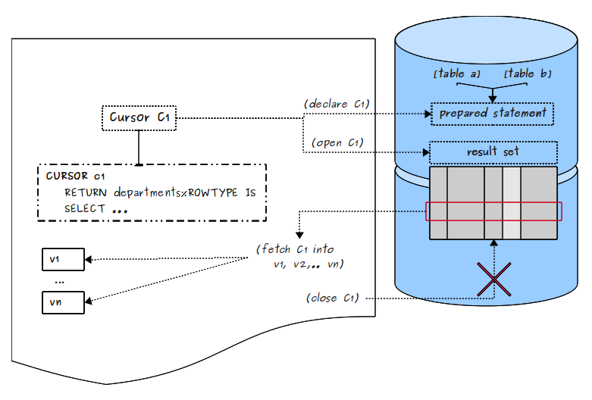

Slide 11
Cursor Declaration
Open
Fetch
Close

Slide 12
Q> Create a cursor that will fatch all the row from the table a where A is greater than 50 and insert those rows into the table b.
SQL> select * from a;
A B C
---------- ---------- ----------
90 20 30
20 30
SQL> select * from b;
no rows selected

Slide 13
SQL>
1 declare
2 cursor aa is
3 select A,B,C from A where A>50;
4 str_A A.A%type;
5 str_B A.B%type;
6 str_C A.C%type;
7 begin
8 open aa;
9 if aa%isopen then

Slide 14
10 loop
11 fetch aa into str_A,str_B,str_C;
12 exit when aa%notfound;
13 if aa%found then
14 insert into B values(str_A,str_B,str_C);
15 end if;
16 end loop;
17 commit;
18 end if;
19 close aa;
20 end;
SQL> /

Slide 15
PL/SQL procedure successfully completed.
SQL> select * from b;
D E F
---------- ---------- ----------
90 20 30

Slide 16
Trigger
Trigger is the pl/sql code which is executed for certain database events like DML operation on table. The user can write triggers on a table or view. Triggers are used to implement complex validation, security and addition and replication of data. The trigger code is fired when the corresponding DML operation is performed on the table to which the trigger is attached.

Slide 17
Creation a DML trigger
To create ( or replace ) a DML trigger, use the syntax shown here.
Create or replace trigger trigger_name
{ before|after}
{ insert|delete|update} on table_name
[for each row]
[when (….)]
[declare]
Begin
…statements….
[exception…]
End;

Slide 18
Q.Write a trigger on table a that will execute when we run any update operation on it and the trigger will insert the old value on table b.
Sql> create or replace trigger t1
after uodate on a
for each row
begin
insert into b values( :old.A,:old.B,:old.C);
end;
/
Sql> update a set A=40 where B=20;

